Slide 1


Sprint 17 Reporting Workshop
Jan Bosch
Director Software Center
www.software-center.se
Professor of Software Engineering
Chalmers University of Technology
Gothenburg, Sweden.
www.janbosch.com
Sprint 17 reporting workshop

Slide 2
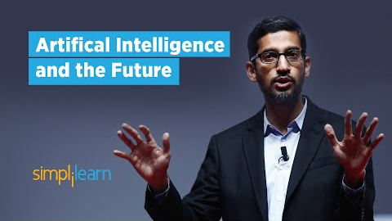

Slide 3

















Software Center
Mission: To significantly improve the digitalization capability of the European Software-Intensive industry

Slide 4





Technology Evolution
digitalization
mechanics
electronics
software
data
artificial intelligence

Slide 5
What Makes A Digital Company?
Using email?
Have a website?
Use social media?
Video conferencing?
Chatbots?
Data-driven decision making
Relentless experimentation (e.g. A/B testing)
Short feedback cycles
Decision making pushed down in organization
Strategic data collection
Unified data warehouse
Pervasive use of AI and automation
New job descriptions

Slide 6
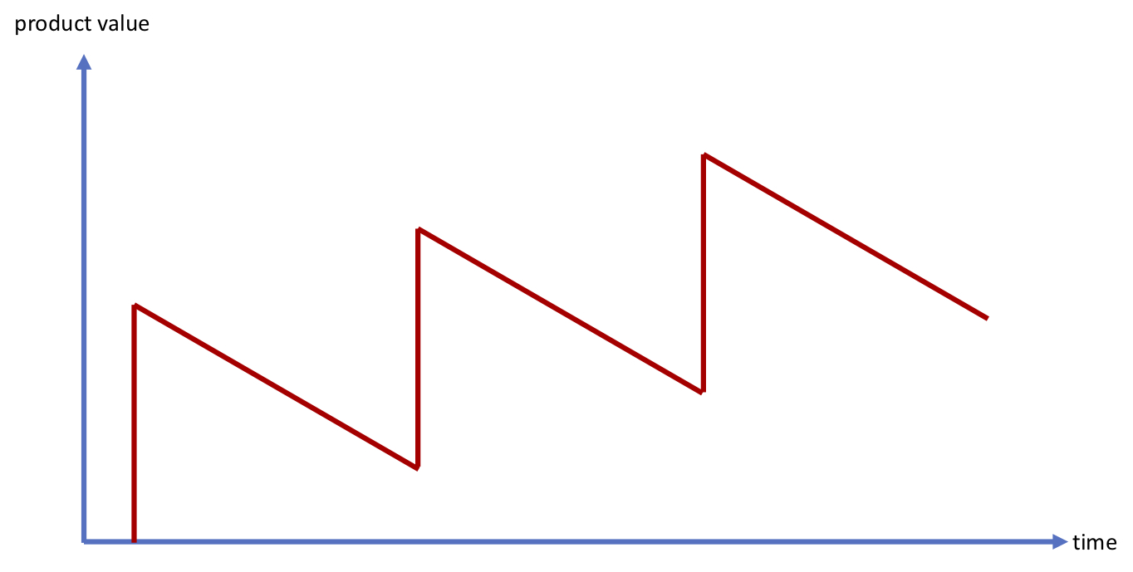
Traditional Value Delivery

Slide 7
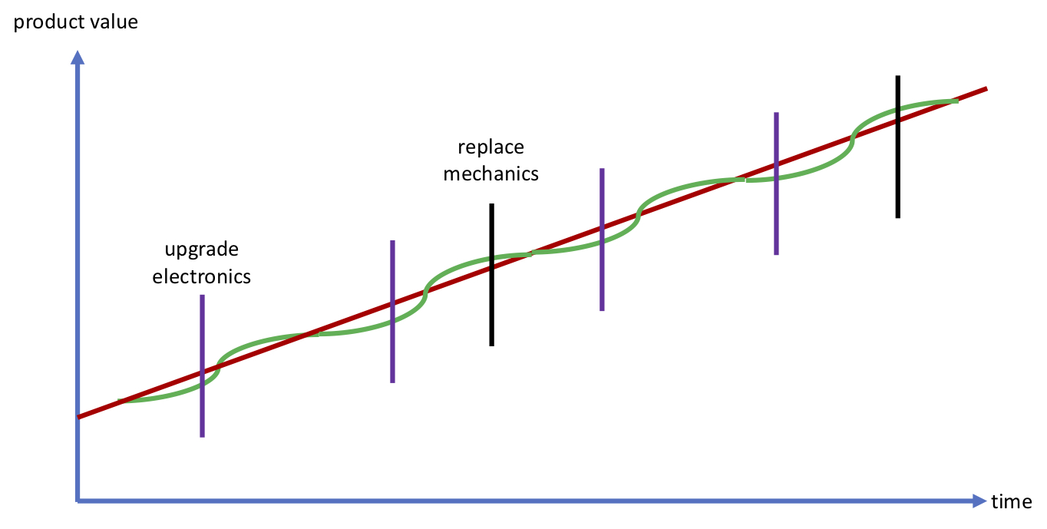
Continuous Value Delivery

Slide 8
A New Collaboration Model
Software Center aims to develop a
strategic partnership
with partner companies to
significantly accelerate their adoption
of novel approaches to digitalization
Research is performed in 6-month sprints
Long term goal; short term value
System-level, holistic perspective, including business, architecture, ways of working and organizational aspects

Slide 9
Research Themes
Application Domain Themes
Autonomous
Systems
WASP
Holistic DevOps Model
Vinnova
Software engineering for AI
CHAIR
Shared
public/partner
funding
Technology Themes
Continuous
Delivery
Continuous
Architecture
Metrics
Customer
Data and
Ecosystems
AI Engineering
Predominantly
partner
funding

Slide 10






Some Online Companies

Slide 11
Advantages for Industry
More consistent, integrated focus on your key change initiatives
Holistic approach including technical, organizational and business aspects
Value every 6 months
Opportunity to steer projects frequently

Slide 12
How are we doing?
Stairway to Heaven
CIVIT model
CAFFEA model
HYPEX model
Metrics-based visualization
Etc.
Active use by the Software Center companies!

Slide 13
How AI Evolves In Industry
Experimentation & prototyping
Critical deployment of ML/DL components
Cascading deployment of ML/DL components
Non-critical deployment of ML/DL components
Autonomous ML/DL components
Increasing need for AI engineering

Slide 14
AI Engineering
explainable
models
safety-critical
systems
federated/
distributed
model
creation
manage
multiple
models
validation
for safety
critical
applications
design methods
and processes
reuse of
predeveloped
models
federated/
distributed
storage of data
create/evolve
ML/DL model
reproducibility
set up data
pipelines
integration
of models &
components
cyber physical systems
deploy on
heterogenous
hardware
assemble
data sets
train and
evaluate
monitoring
& logging
deployment
transfer
learning
(automated)
labelling
A/B testing
of models
data quality
management
autonomously
improving systems
mass-customization
of models
storage and
computing
infrastructure
data
generation
for
machine
learning
automated
experimentation
AI/data science
AI engineering
dom. spec. AI eng.

Slide 15
Visitors
DEIF
Siemens Gamesa
Infotiv
DeLaval
MindRoad
…

Slide 16
Communities in Software Center
Digitalization workshops
(twice/year)
general management
(strategy, innovation, resource allocation, etc.)
Systems engineering community
Product management community
FUSA & CD workshops
system R&D
product management
SW R&D
(architecture, development and testing)
certification, release, support, maintenance
Notes:
Digitalization - Continuous Software- and Data-Driven Business

Slide 17
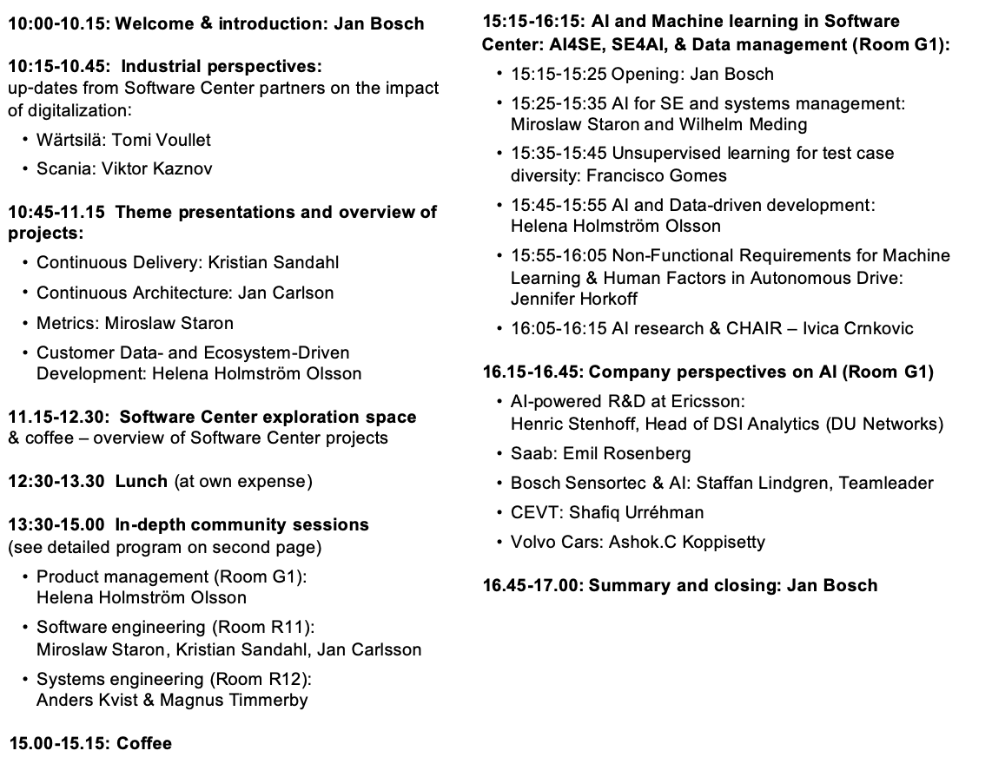
Agenda

Slide 18
Conclusion
Thanks for all of you, Software Center is doing GREAT!
  More partners
  More projects
  Broader scope
Next step: drive data-driven business ecosystems and AI engineering as a key complement to our existing research

Slide 19
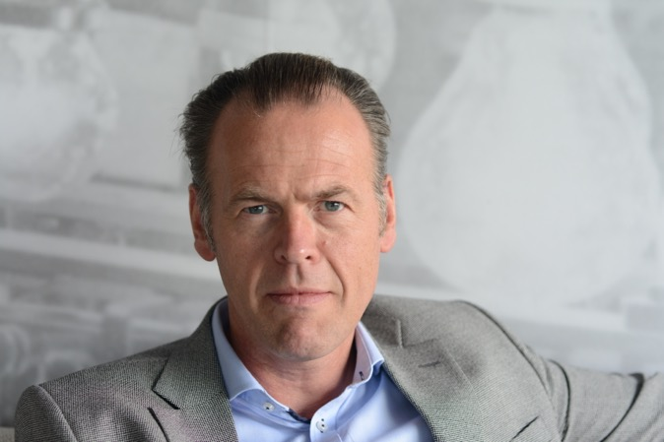

www.software-center.se
Chalmers University of Technology
www.janbosch.com
jan@janbosch.com
Follow me on LinkedIn, Twitter (@JanBosch) or www.janbosch.com/blog

Slide 20
Product Management Community
Jan Bosch
Director Software Center
www.software-center.se
Professor of Software Engineering
Chalmers University of Technology
Gothenburg, Sweden.
www.janbosch.com
Sprint 17 reporting workshop

Slide 21

Digitalization
Digitalization is the use of digital technologies to change a business model and provide new revenue and value-producing opportunities; it is the process of moving to a digital business.
- Gartner

Slide 22
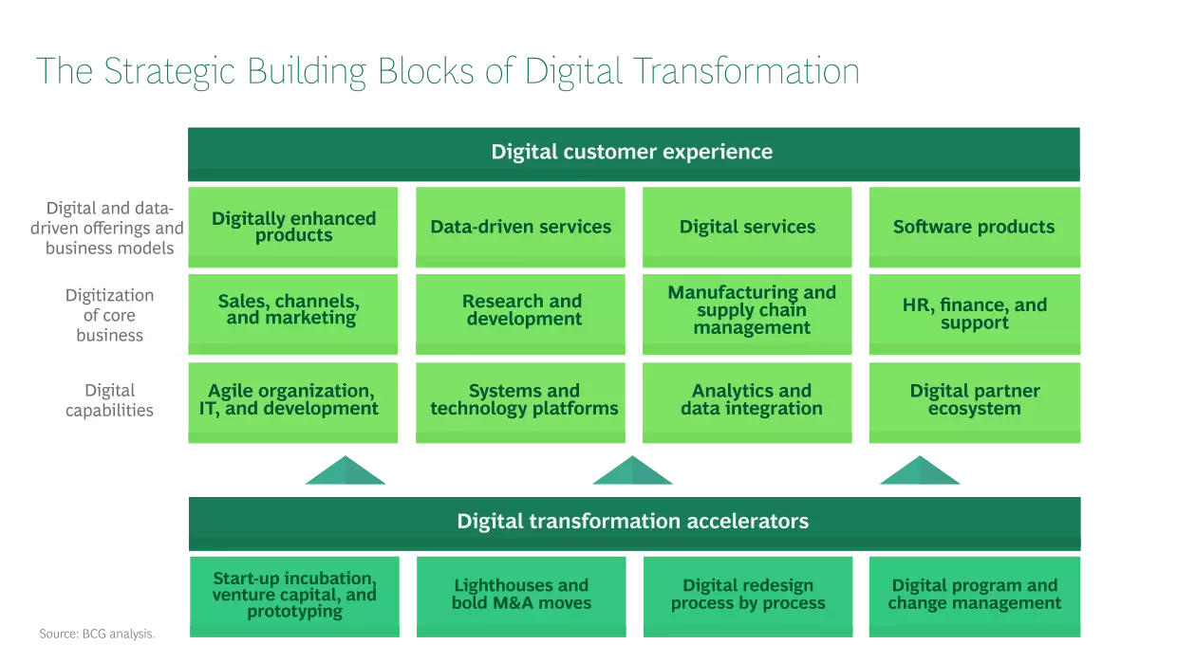
Digitalization

Slide 23
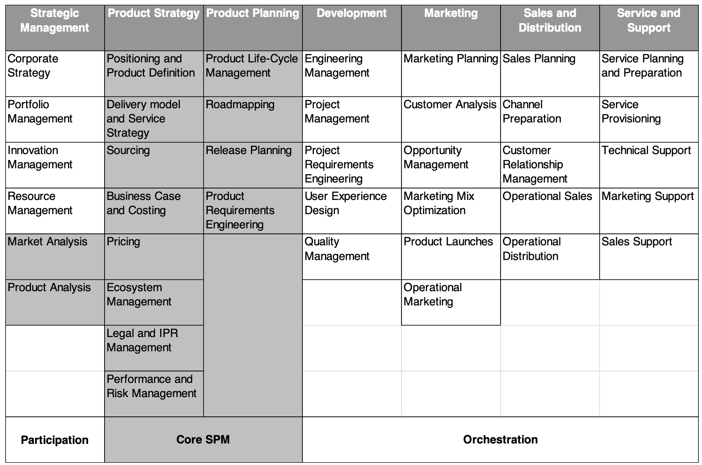
ISPMA

Slide 24
Technology Evolution
digitalization
mechanics
electronics
software
data
artificial intelligence

Slide 25
Business Evolution

Slide 26
Disruption Model
D
new entrants
novel
expressed customer need
new/evolved
ecosystem
novel, better way to meet customer need
real customer need
new
technology/
capability
C
incumbents
E
conventional expressed customer need
traditional
ecosystem
customer
need
centered
traditional way to meet customer need
product
capability
centered
A
B
Expressed customer need = f(real customer need, technology capability, cost)

Slide 27
Instantiated For Digitalization
novel expressed customer need
digital
offering
multi-dimensional
business model
”as a service”
connectivity
data collection &
analytics
continuous
deployment
pay for use
quality of
service contracts
insights based
on data
monetizing aggregated data
subsidizing some ecosystem
partner types
network effects & virtuous cycles
real customer need
new
technology/
capability
conventional expressed customer need
buy & own
product
physical
offering
one-dimensional
business model

Slide 28
Traditional Value Delivery

Slide 29
Continuous Value Delivery

Slide 30
PdM manifesto
From
To
Requirements-driven
Many customer-specific branches (customization)
Functionally organized teams (silos)
Decision-making based on an understanding of the customer’s view (’what customers say’)
Optimizing for planning and paperwork purposes
Outcome-driven practices
A single branch (with configurations)
Cross-functional teams (including product owner)
Data-driven decision-making (’what customers do’)
Optimizing for value creation by development teams

Slide 31
Conclusion
Product management provides the cross-company coordination to exploit the opportunities of digitalization
Product management itself needs to change as a discipline as well
Software Center PM community provides a context in which to learn, explore and accelerate change

Slide 32
AI and Machine Learning
Jan Bosch
Director Software Center
www.software-center.se
Professor of Software Engineering
Chalmers University of Technology
Gothenburg, Sweden.
www.janbosch.com
Sprint 17 reporting workshop

Slide 33
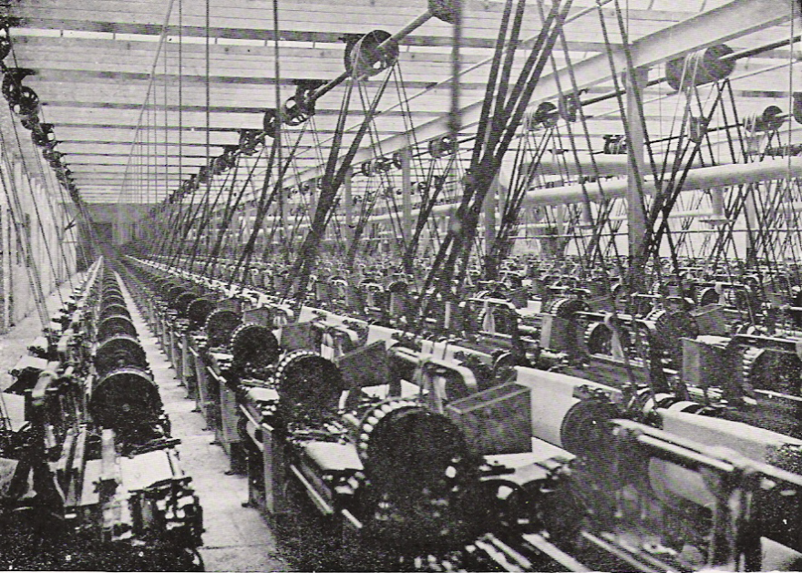
AI: The New Electricity

Slide 34
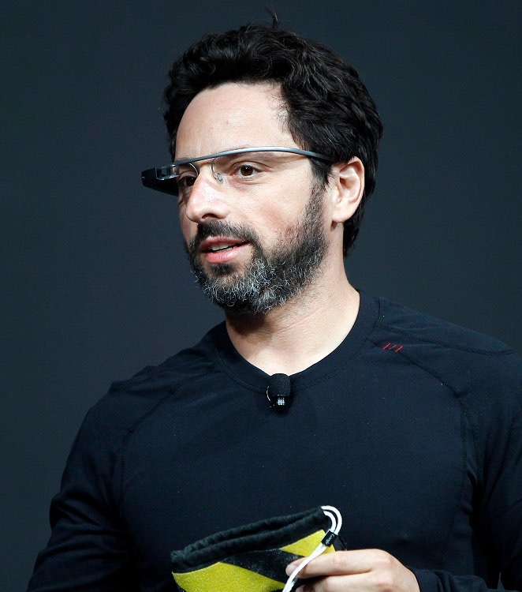
The new spring in artificial intelligence is the most significant development in computing in my lifetime
— Sergey Brin, President ALPHABET

Slide 35
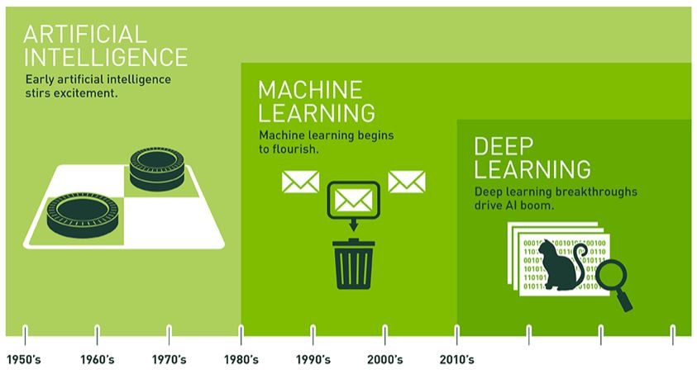
Artificial Intelligence

Slide 36
Why Machine Learning Revolution now?
INCREASE OF TRAINING DATA
INCREASE OF COMPUTING POWER
Large datasets of labeled training data like ImageNet
2
Especially GPUs &
Distributed Computing.
1
3
ALGORITHMIC IMPROVEMENTS
4
BETTER TOOLING
Especially in deep reinforcement learning but also normal DL (ReLUs [Dahl et al., 2013], Dropout [Srivastava et al., 2014], etc.)
Libraries like TensorFlow and Cloud Services

Slide 37




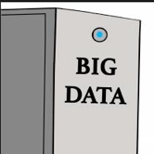


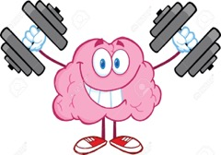
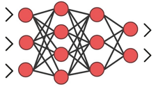
The Typical Problem
problem

Slide 38
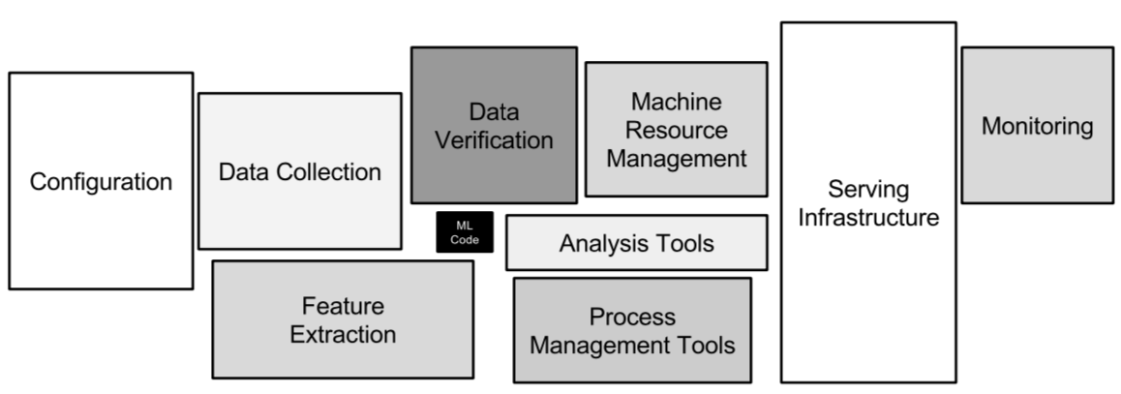
Why Software Engineering For Machine Learning?
Google: D. Sculley, G. Holt, D. Golovin, E. Davydov, T. Phillips, D. Ebner, V. Chaudhary, M. Young, J.-F. Crespo, and D. Dennison,
“Hidden technical debt in machine learning systems,” in Advances in Neural Information Processing Systems, 2015, pp. 2503–2511

Slide 39
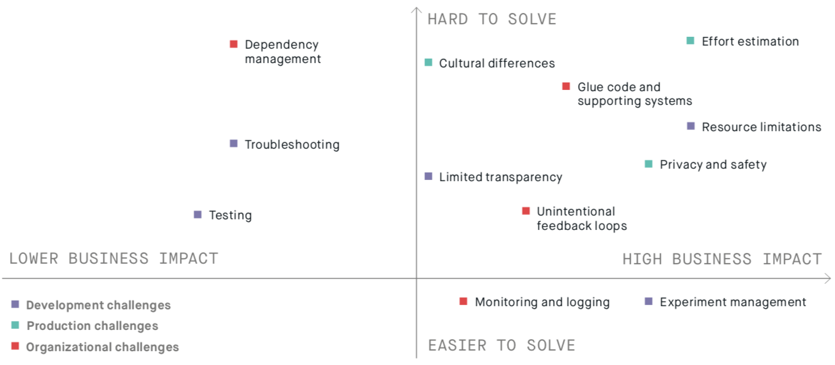
From one of our studies …

Slide 40
Where The Effort Goes …
assemble datasets
create models
train and evaluate
deployment
Amount of effort
Amount of attention

Slide 41
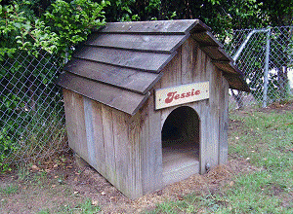

What’s the Difference?
Most Academic Research
Engineering Research
study benefit & scalability in empirical RW context
Characteristics
Small-scale
Few people
Pilots & prototypes
No/little societal value
No risk
Characteristics
Large scale
Hundreds/thousands of people
Industrial, critical deployment
High societal value
High risk
study applicability of technology

Slide 42
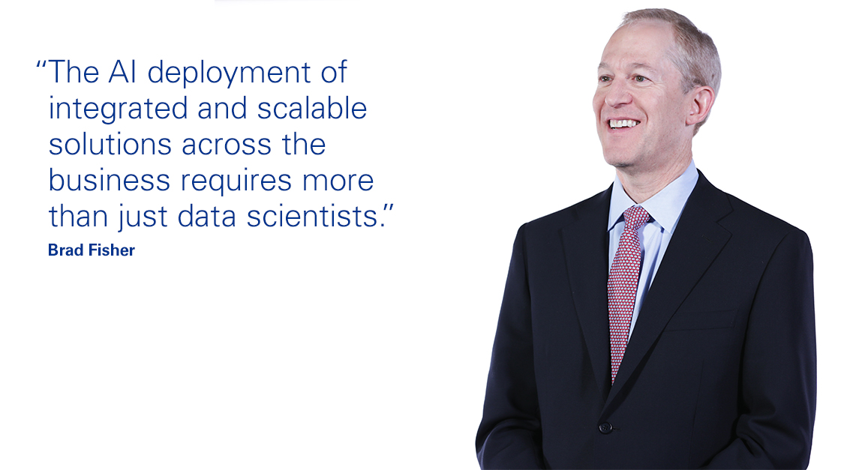
Quote from KPMG
“One of the biggest problems facing businesses is
getting AI from pilot phase to scalable deployment”
KPMG Consulting

Slide 43
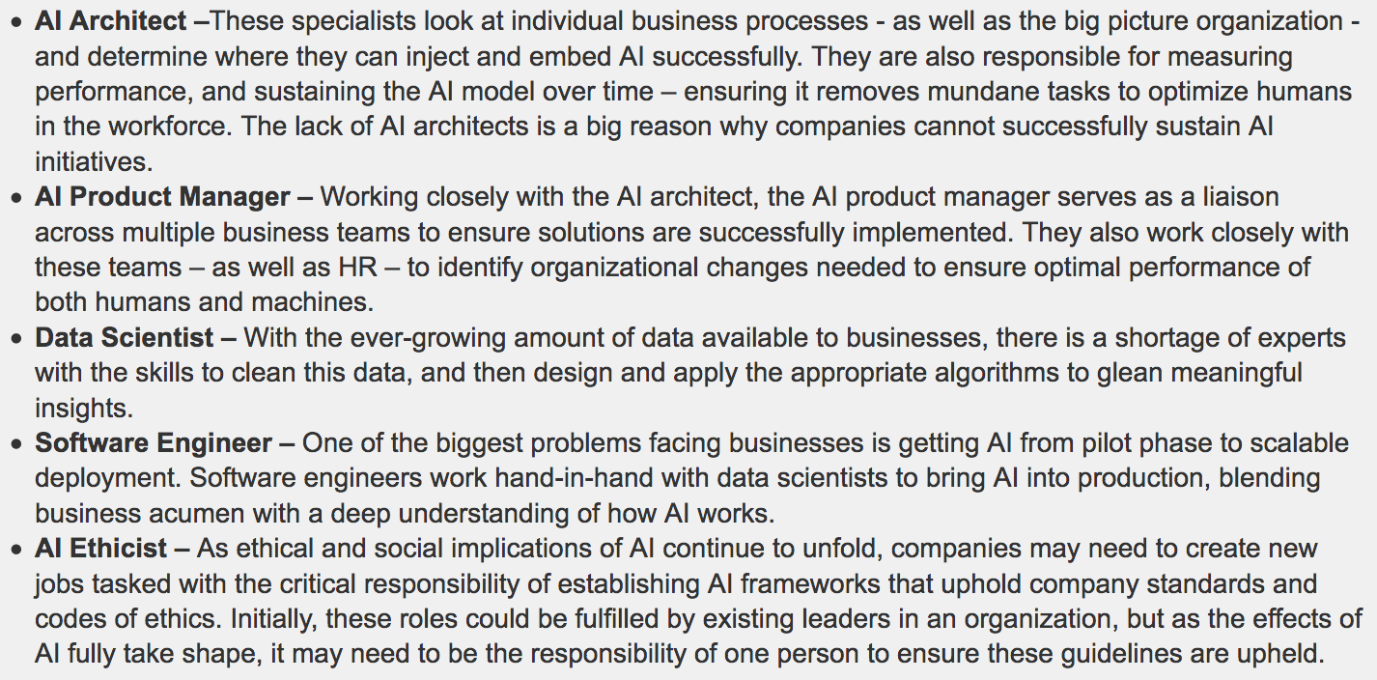
Five Most Important Jobs in AI
Software Engineering
https://info.kpmg.us/news-perspectives/technology-innovation/top-5-ai-hires-companies-need-to-succeed-in-2019.html
https://qz.com/work/1517594/the-five-most-important-new-ai-jobs-according-to-kmpg/

Slide 44
How AI Evolves In Industry
Experimentation & prototyping
Critical deployment of ML/DL components
Cascading deployment of ML/DL components
Non-critical deployment of ML/DL components
Autonomous ML/DL components
Increasing need for AI engineering

Slide 45
Holistic DevOps Framework
Holistic DevOps Framework
Requirements driven development
Regulatory features
Competitor parity features
Commodity features
Outcome/data driven development
Value hypothesis
New ”flow” features
Innovation
AI driven development
Minimize prediction errors
Many points in data set
Combinatorial explosion of alternatives
continuous deployment
behavior data
AI component
SW component
continuous deployment
behavior data
System in operation

Slide 46
AI Engineering
explainable
models
safety-critical
systems
federated/
distributed
model
creation
manage
multiple
models
validation
for safety
critical
applications
design methods
and processes
reuse of
predeveloped
models
federated/
distributed
storage of data
create/evolve
ML/DL model
reproducibility
software-intensive
embedded systems
set up data
pipelines
integration
of models &
components
deploy on
heterogenous
hardware
assemble
data sets
train and
evaluate
monitoring
& logging
deployment
transfer
learning
(automated)
labelling
A/B testing
of models
data quality
management
autonomously
improving systems
mass-customization
of models
storage and
computing
infrastructure
data
generation
for
machine
learning
automated
experimentation
AI/data science
AI engineering
dom. spec. AI eng.

Slide 47

Conclusions
Digitalization (software, data & AI) is disrupting industry and society to an extent that we have only seen the early beginnings of
Companies that do not proactively adopt AI throughout
their entire business (products and ways of working!)
risk disruption
Productifying AI/ML/DL solutions and deploying in industrialized contexts is a major challenge

Slide 48
Sprint 17 Reporting Workshop
Closing …
Jan Bosch
Director Software Center
www.software-center.se
Professor of Software Engineering
Chalmers University of Technology
Gothenburg, Sweden.
www.janbosch.com
Sprint 17 reporting workshop

Slide 49
Software Center
Mission: To significantly improve the digitalization capability of the European Software-Intensive industry

Slide 50



Feedback and Closing
One thing you liked
One thing you wished for
One thing you’re going to different after today

